Slide 1

Web Search Engine Comp 8547: Advanced Computing Concepts MAC FALL 2021
Instructor: Presented by:
Dr Mahdi Firoozjaei Varun Ahuja
Hafsa Shabbeer
Abrar Ibna Mizan

Slide 2
Content
Team Roles
Introduction
Features
Live Demo
Conclusion

Slide 3
Team Roles Hafsa Shabbeer Conversion of HTML to Text Varun Ahuja Word Frequency Count Abrar Ibna Mizan Pattern Searching

Slide 4
Introduction What is a Web Search Engine? A Web Search Engine is a service that helps us to find other web pages. It is normally accessed through a web page or a browser. When ever a user enters a search query it crawls through the web and gives the information based on the provided query. Ex: Google, Firefox, Bing and DuckDuckGo

Slide 5
Features HTML to Text Firstly, we read the HTML file stored in the local directory. Then we convert the HTML file to Text file using Jsoup library. Basically, get all the plain text inside every HTML tags. Jsoup is used to parse, manipulate and extract data present in HTML tags.

Slide 6
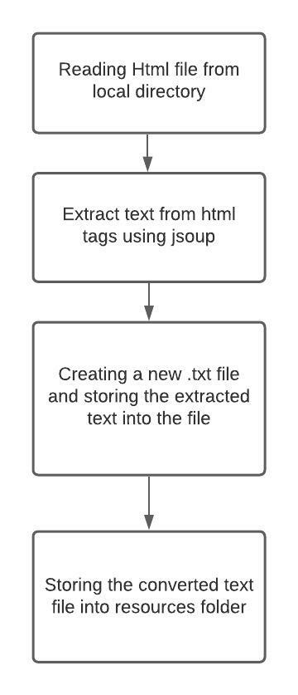
Flow Diagram

Slide 7
Word Frequency Count After generating the text file from html file that text file is further used from the local directory for counting the frequency of words. The total number occurrence of each word in the file is calculated.

Slide 8
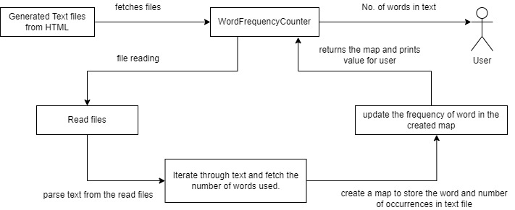
Flow Diagram for Word Frequency Count

Slide 9
Pattern Finder The same text file used for counting the frequency of words is used for Pattern Finder. The user is asked to enter a word and the program searches for that word in the text file, it return true if found or else false.

Slide 10
Live Demo

Slide 11
Conclusion
Understood the concepts taught in the classroom and implement them in real time.
Got a chance to see the practical implementation of web search engine.
Learnt to recognize which concept is best for an effective application.
Learnt how to work in a team.

Slide 12
Thank You

